Slide 1
全球创新战略
Global Innovation Strategy
顧學雍
benkoo@tsinghua.edu.cn
2月18日，2020
Notes:
今天的主题是“区块链启发的新产业范式”

Slide 2
Learn to Analyze and Compose Innovation Strategies at Global Scale with trust-worthy Data

Slide 3
Strategy is analytical/compositional
科技 （Technology）
Manufacturing/Transport/Transaction
人才 （Talent）
Brain Drain
Full Time/Part Time/Distant Workers
制度的包容性 （Tolerance)
Work across the Internet？
Smart Contract/Distributed Ledger?
http://www.creativeclass.com/richard_florida/books/the_rise_of_the_creative_class_revisited

Slide 4
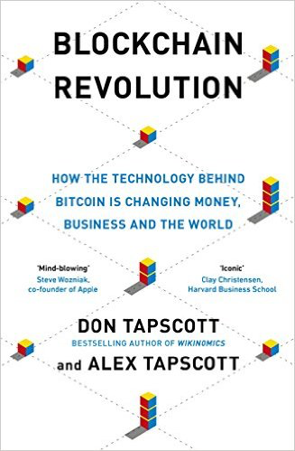
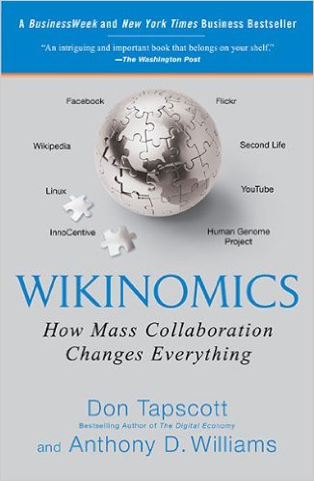
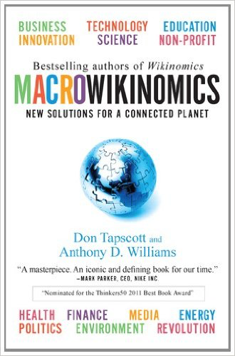
协同科技：Collaboration Technologies

Slide 5


National Manufacturing Strategies
USA: Cyber-physical Systems
Germany: Industry 4.0
Japan: Innovation 2030
China Manufacturing 2025
http://www.miit.gov.cn/n11293472/n11293832/n11293907/n11368223/16489095.html
Published by US Department of Commerce

Slide 6
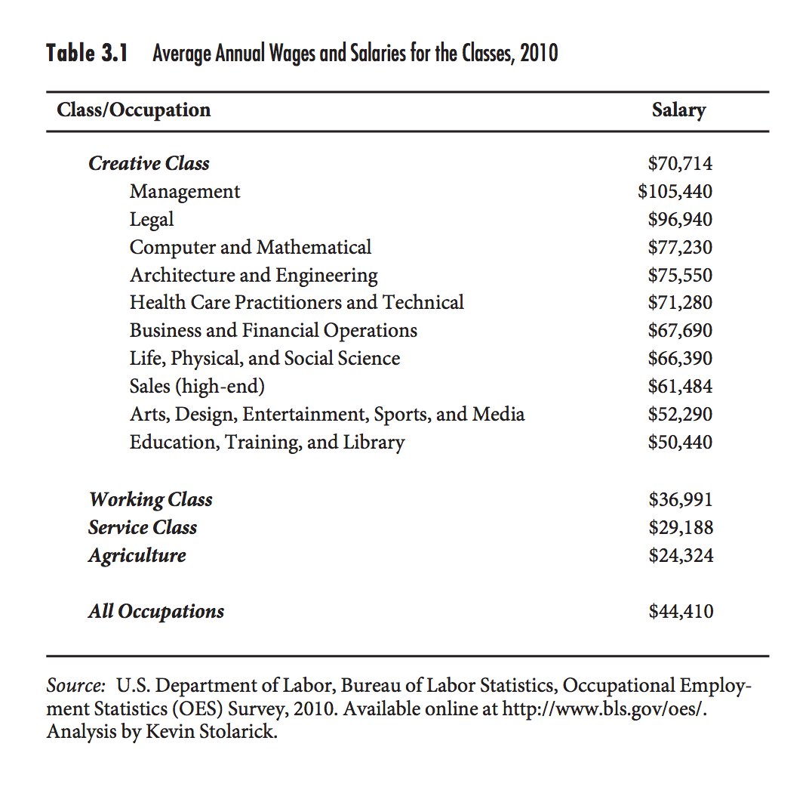
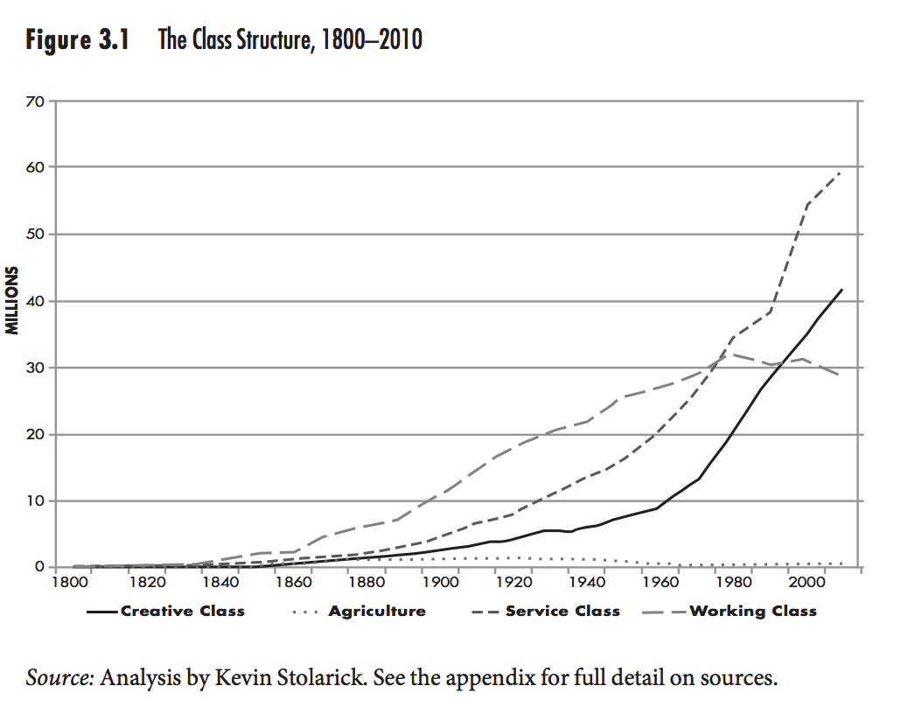
Assertions based on Data Analysis
p.42 of The Rise of the Creative Class, Revisited
p.45 of The Rise of the Creative Class, Revisited

Slide 7
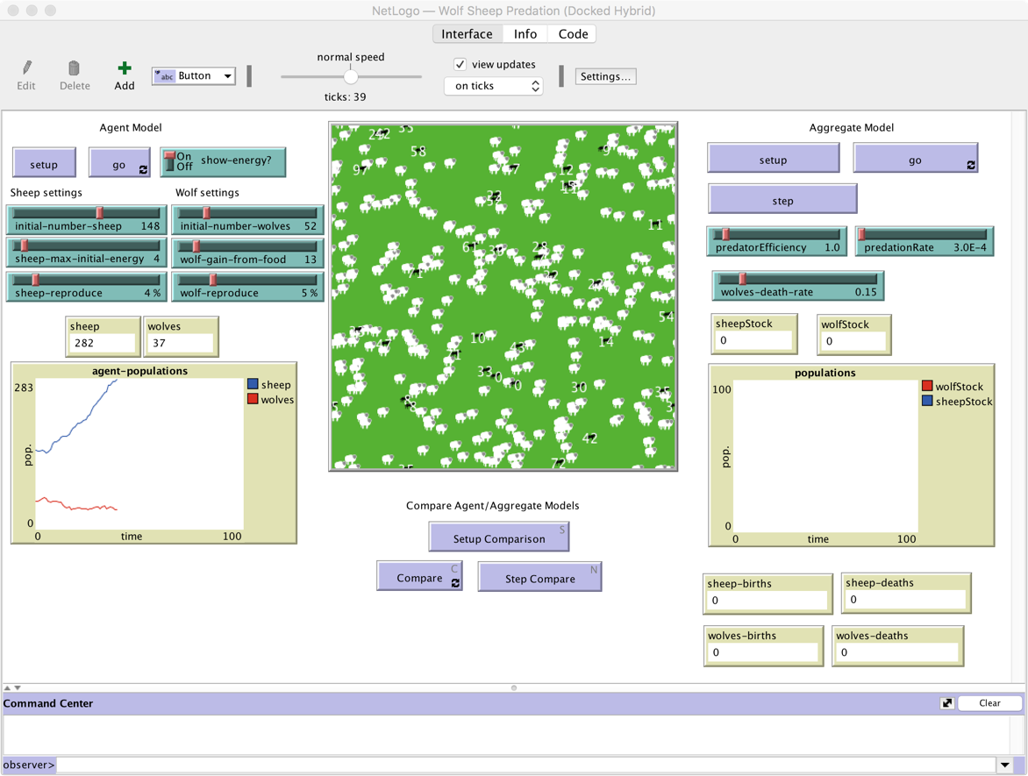
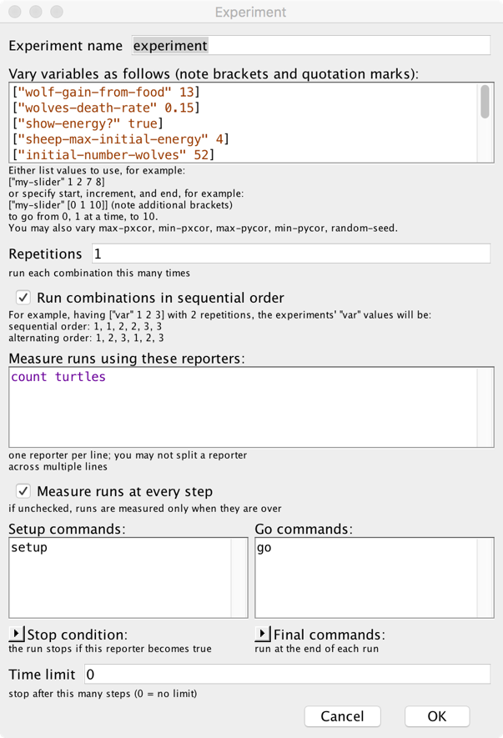

Use Simulation tools to create what-if-scenario-data（NetLogo)

Slide 8



The foundational metrics
Trust-worthiness
超限
Time
Space

Slide 9
What is “Computational” about this course?
Emphasis the Language-Oriented Approach to manage knowledge:
词汇：Vocabulary Management: Name Space in Wiki
语法：Innovation models are compositions of existing Verbs and Nouns
语境：The meaning of strategies must be interpreted dynamically in context

Slide 10
Four basic elements
Strategy Formation as a model of Computation
评价创新性与战略决策的有效性的度量衡：Performance metrics of Innovativeness and Effectiveness of Strategies
关键人物与组织的互动效应：Interaction Effects: The “Strategic” Agents and Agencies in the Global Society
决策与创作型规划的科学： The Science of Idea Generation and Decision Making on a Global Scale

Slide 11
Innovation Strategies as Models of Computation
The era of Super-Human Intelligence
Adder: Traditionally, Global Strategy was based on Zero-Sum Resource Competition
Memory: The Time Dimension of Strategic Planning
Composition: The building blocks of industrial systems
From Fuel, to Engine: an approach to re-direct use of energy
From Energy to Executing Intelligent Reasoning

Slide 12
Measurements of Innovativeness and Effectiveness of Strategies
The Engines of Digital Age: CPU/GPU/Quantum
Human Interfaces to Computational Resources
Virtualization of Machines
Abstractions, Protocols, and Trust-worthiness
Midterm Presentation by all teams
Present a finalized version of the Logic Model if your team IAR
Present your Learning Process Data
Wiki history
Gitlab check-in history
Personal and Team contribution assessment
Self-reflection on progress and correction strategies

Slide 13
The Composition of “Strategic” Agents and Agencies
Compiler as a strategic technology for all kinds of organizations
Compiler as the core of computational knowledge management
Why is digital security suddenly a major force in Global Innovation?
Operating System as a Computational Constitution
Networked Operating Systems
Byzantine Generals’Problem
The Operating System for Internet of Things (IoT)
Connection Science at MIT

Slide 14
The Science of Idea Generation and Decision Making
Trust-worthiness in Network Communication
Seven Layers of OSI Communication
The mathematics and believeability of system composition
Matrix the Movie and the Data-Driven Programming Model
Code is Data and Data is Code, Tensorflow as a product
Tools vs. Strategies (Yuan Xun)
Tools must be Simple, and Strategies must be Mysterious
The Great Finale
Coordinated Presentations amongst all teams
Demonstrate your Industry Analysis Report
Learning Process Data and its analysis

Slide 15
战略分析的可信度
Trust-worthiness of your Industry Analysis Reports comes from:
Your diligence and persistent effort in managing reference material
Your interpretation of content
The quantity and quality of efforts expended in reviewing your own work.

Slide 16
第一周个人任务：进入计算思维的学习时代
Identify themselves into a team within the class.
Create an Private-Public Key pair on our blockchain-based system
Install Git, create a personal and group-wise Gitlab account
Create a Wiki account on Toyhouse.cc, and start writing weekly learning report
Contributing at least three non-repeating entries of references to the first three lectures (total of 9 entries), following proper literature review format.
Each reference entry must have at least 30 words description and pointer to key ideas.
Install Mathematica, Python, NetLogo, and Eclipse
Learn to read and follow Wiki's name management convention, understanding the basics of knowledge management in wiki context
Suggested Reading: A Brief History of Tomorrow by Yuval Harari

Slide 17
第一周现场任务：自我介绍 Self Introduction
Your Name, Department/Institution, the year in School
Your interest or impression in Globalization, Innovation Practice, and Strategic Planning
What is your impression about Computational Thinking
Do you use Wiki? Have you used Git/Github/GitLab…
What are your technical expertise. Art Design, Animation, Video Editing, Programming …
What are your personal interest, Painting, Poem Writing, Soccer, Swimming …
What is your most favorite book
What is the most interesting thing you just worked on recently?

Slide 18
02
Tools
02

Slide 19



Demo Time
01
02
NetLogo
Mathematica
極限學習過程
極限學習過程
19

Slide 20
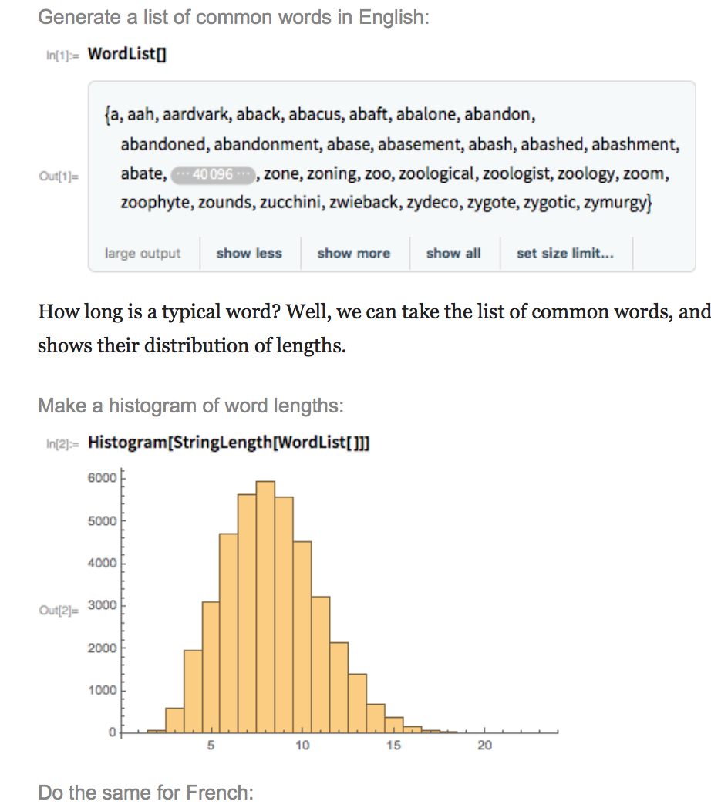
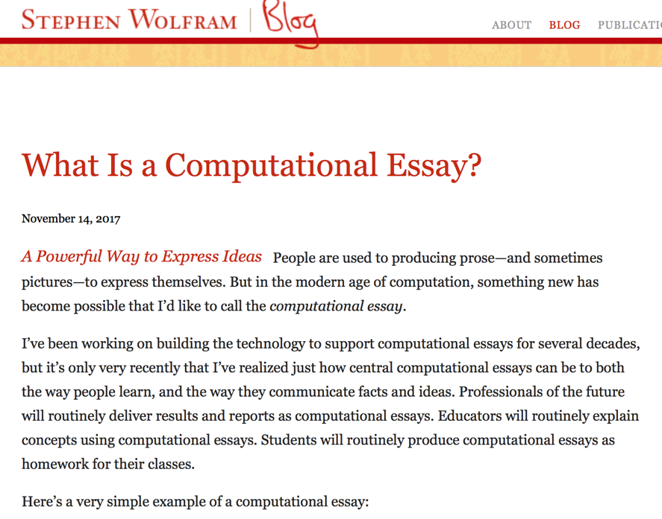
Computational Essay?
http://blog.stephenwolfram.com/2017/11/what-is-a-computational-essay/

Slide 21
Super Human Intelligence
Google DeepMind Beats Lee Se Dol in Go Game

Slide 22
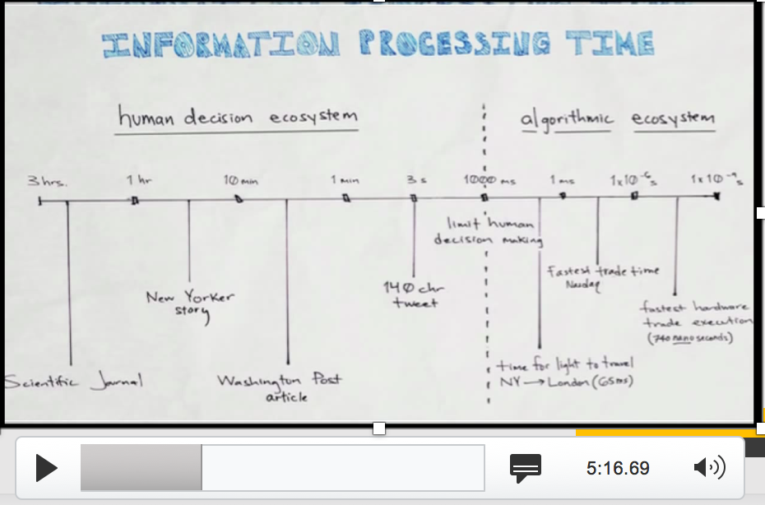
Super Human Intelligence on Wall Street
Sean Gourley on High Frequency Trades and Algorithms
https://www.youtube.com/watch?v=V43a-KxLFcg

Slide 23
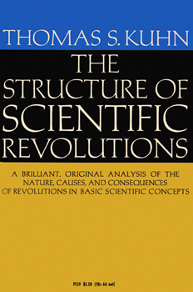

产业与科学革命的知识体系奠基人：Thomas Kuhn
Thomas Samuel Kuhn (/ˈkuːn/; July 18, 1922 – June 17, 1996)
https://en.wikipedia.org/wiki/Thomas_Kuhn

Slide 24
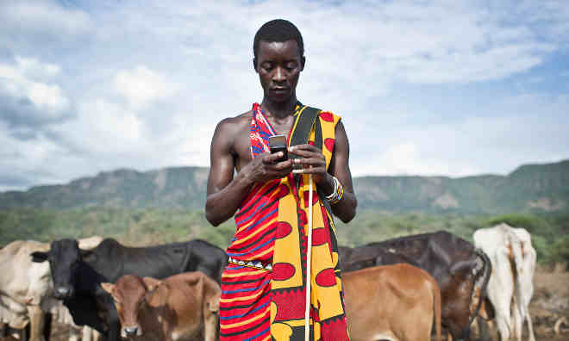
关键词：Incommensurability （不可通约）
产业创新导致行为“范式”的转移
Paradigm shift (范式转移）
传统产业的范式，不再适用于新的社会环境
http://plato.stanford.edu/entries/incommensurability/
http://foodtank.com/news/2015/01/five-ways-cell-phones-are-changing-agriculture-in-africa

Slide 25
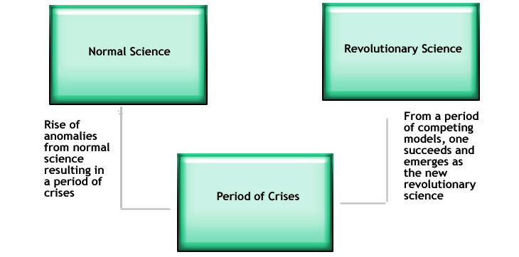
理解效果跟比喻的恰当性
http://structural-communication.com/Articles/Anatomy-metaphor-stclair.html

Slide 26
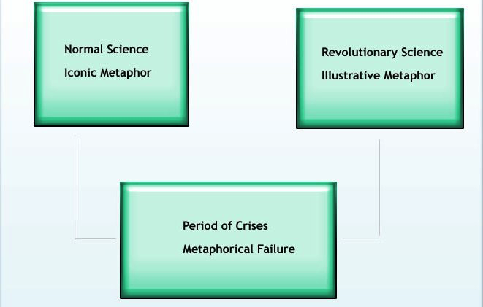
新的科学需要经过新的比喻体系
http://structural-communication.com/Articles/Anatomy-metaphor-stclair.html

Slide 27
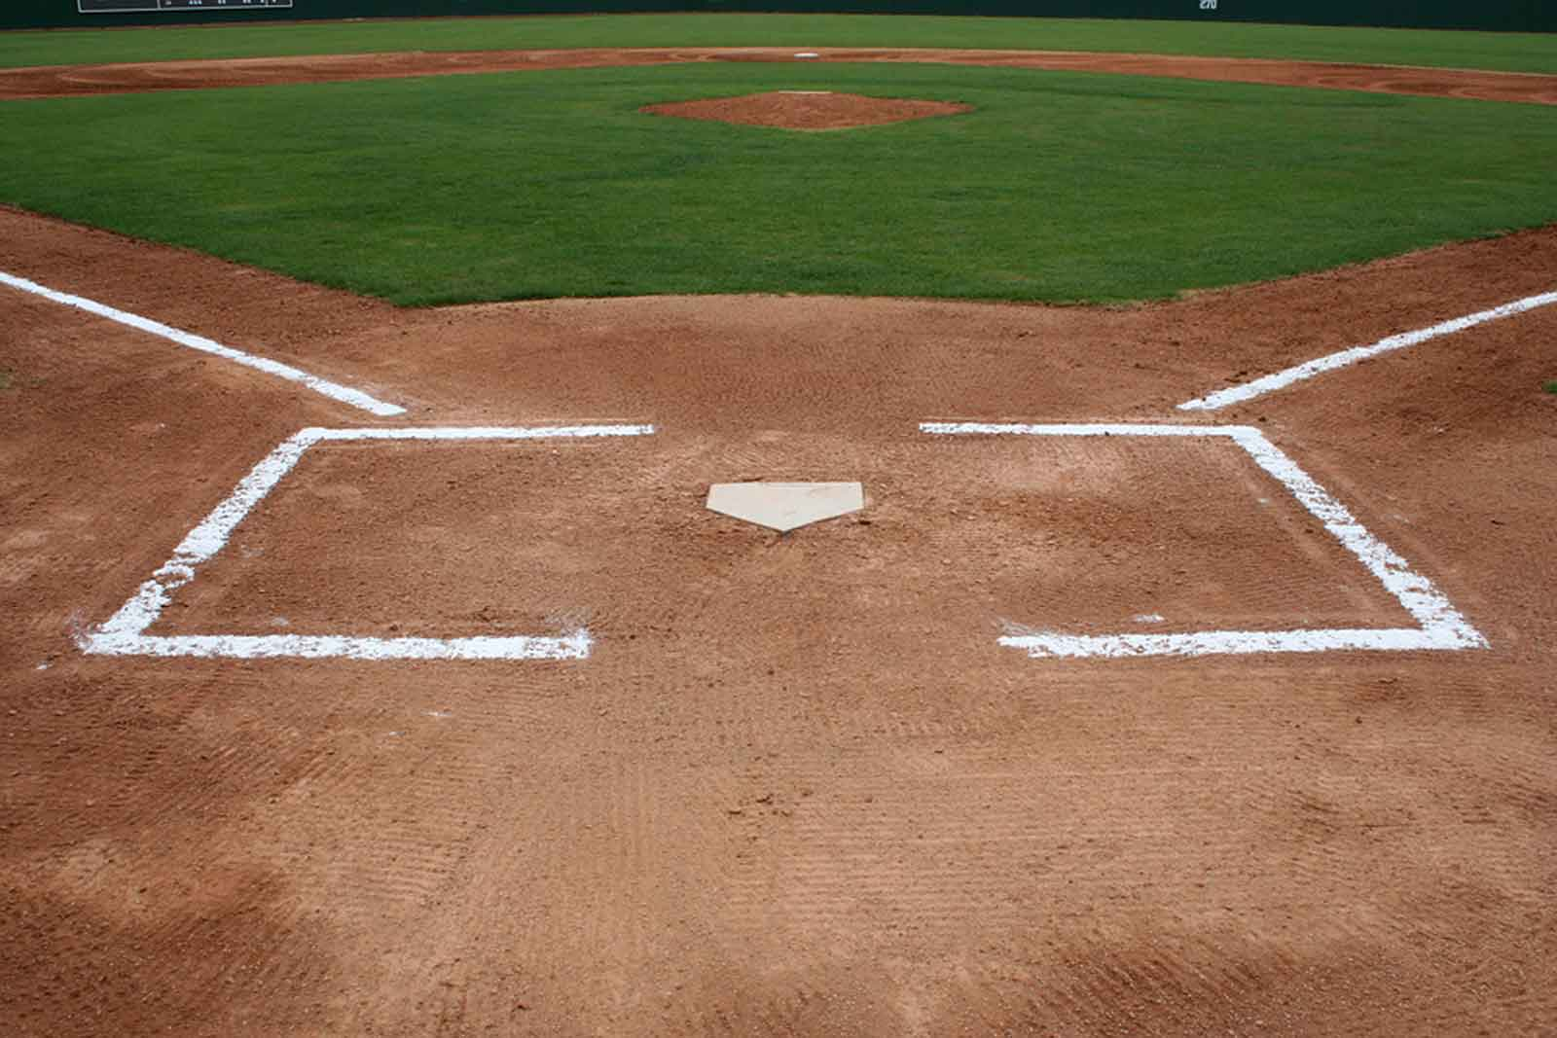
本体比喻 (Ontological Metaphor)
Relate abstract concepts and ideas in terms of “well-known” objects.
A “Home”base
http://neousssabaseball.com/2wsx3edc/wp-content/uploads/2012/09/Baseball-Field-at-Home1.jpg

Slide 28
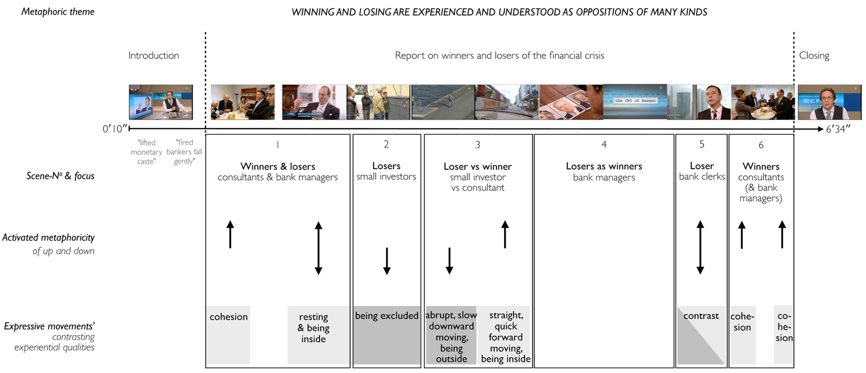
空间比喻 (Orientation Metaphor)
Audio-visual metaphors of the financial crisis: meaning making and the flow of experience
http://www.scielo.br/scielo.php?script=sci_arttext&pid=S1984-63982015000200311

Slide 29
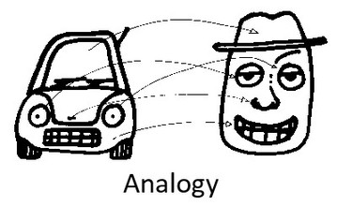
系统比喻 （System Metaphor)
http://www.eoht.info/page/Analogy

